Slide 1

Vel Tech Rangarajan Dr. Sagunthala R&D Institute of Science and Technology
School of Computing
Department of Computer Science and Engineering
10211CS224 / FULL STACK APPLICATION DEVELOPMENT (JAVA)
PROJECT REVIEW : MILESTONE PROJECT – 2
Date: 20-04-2026
Smart Campus Event Management System
SDG: SDG No – SDG Title(Example: SDG 4 – Quality Education)
Presented By:
G. Srinivasa Anil Kumar
VTU26558 - 23UECS0197
Courses Handling Faculty:
Dr.Angelina Lyinda

Slide 2

INTRODUCTION
The Campus Event Management System is a web-based application designed to manage college events efficiently. It allows students to view event details and register online. Administrators can create, update, and manage events easily. The system provides a centralized platform for all event-related activities. It reduces manual work and paperwork. It improves communication between students and organizers. The system ensures better organization of events. Overall, it enhances efficiency and user experience.
1
2
3
4
5
6
7
8
9

Slide 3
PROBLEM STATEMENT
Traditional event management in colleges is mostly manual and time-consuming. It involves paperwork and manual record maintenance. Students may miss event updates due to lack of communication. Managing registrations becomes difficult for administrators. Data redundancy and errors are common in manual systems. Tracking participants is not efficient. There is no centralized system for event information. Hence, an automated solution is required.
1
2
3
4
5
6
7
8
9

Slide 4
OBJECTIVE(S)
To develop an efficient event management system. To provide easy online registration for students. To reduce manual work and paperwork. To maintain accurate and centralized data. To improve communication between users and admin. To ensure quick access to event information. To enhance user experience with a simple interface. To support effective decision-making and management.
1
2
3
4
5
6
7
8
9

Slide 5
PROPOSED SYSTEM
1
The proposed system is an online platform that automates event management processes. It allows students to register, view events, and participate easily, while administrators can manage events, monitor registrations, and update event information in real time.
2
3
4
5
6
7
8
9

Slide 6
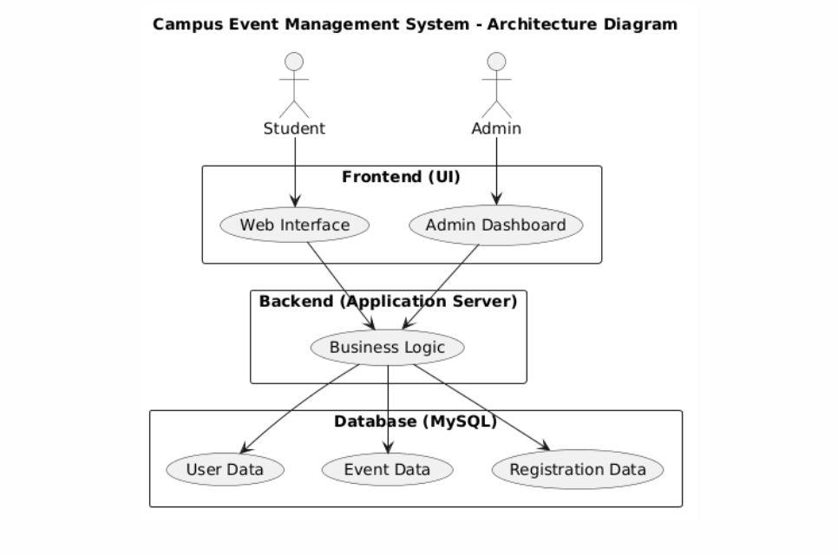
PROPOSED SYSTEM ARCHITECTURE
1
2
3
4
5
6
7
8
9

Slide 7
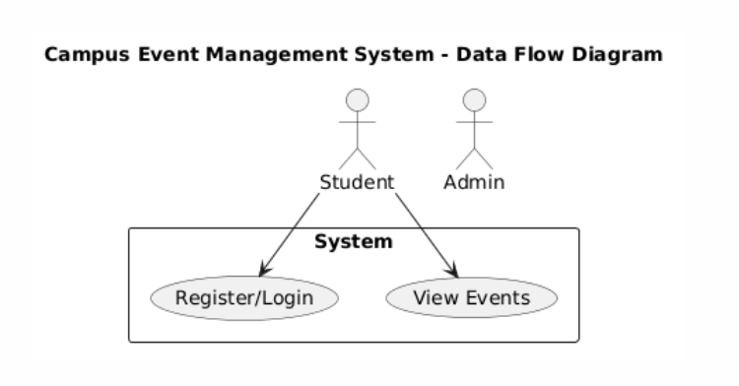
WORKFLOW
1
2
3
4
5
6
7
8
9

Slide 8
TECHNOLOGIES USED
Frontend:
HTML5, CSS3, JavaScript used for designing user interface and interactive web pages.
Backend:
PHP used for server-side processing and handling user requests
Database:
MySQL used to store and manage data such as users, events, and registrations.
Tools:
XAMPP for local server.
VS for coding.
PhpMyAdmin for database management.
1
2
3
4
5
6
7
8
9

Slide 9
MODULE DESCRIPTION
Module 1: User Management Handles student and admin registration, login, and profile management with secure authentication.
Module 2: Event Processing Implements core functionalities like adding events, viewing events, and managing event participation.
Module 3: Database Management Manages storage and retrieval of data related to users, events, and registrations while ensuring data integrity.
Module 4: Reporting & Analytics Generates reports such as participant lists and event summaries for effective decision-making.
1
2
3
4
5
6
7
8
9

Slide 10
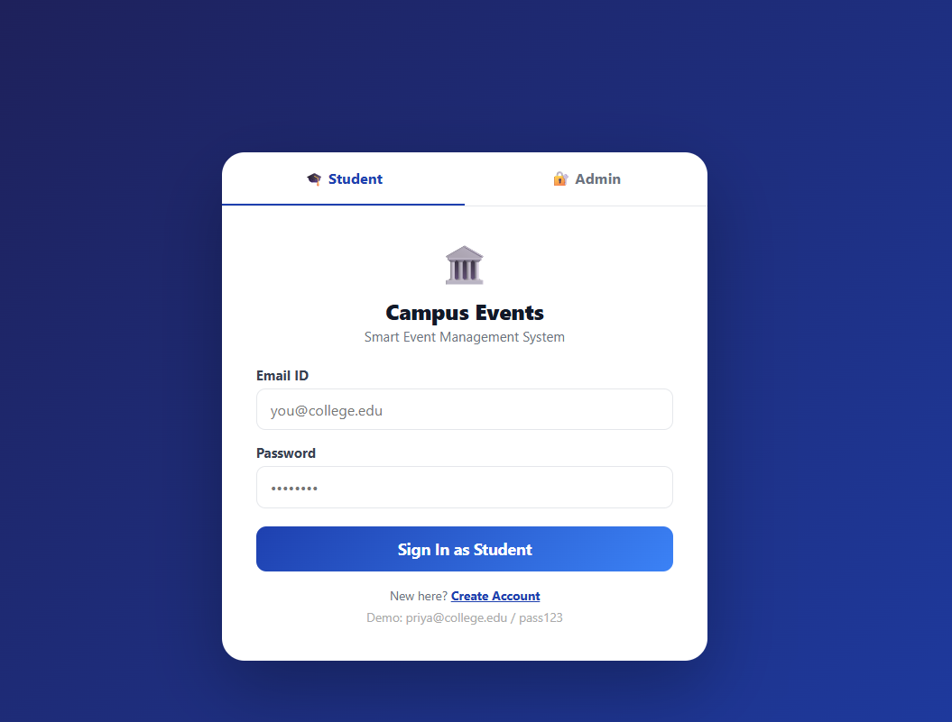
IMPLEMENTATION SCREENSHOTS
Login page
1
2
3
4
5
6
7
8
9

Slide 11
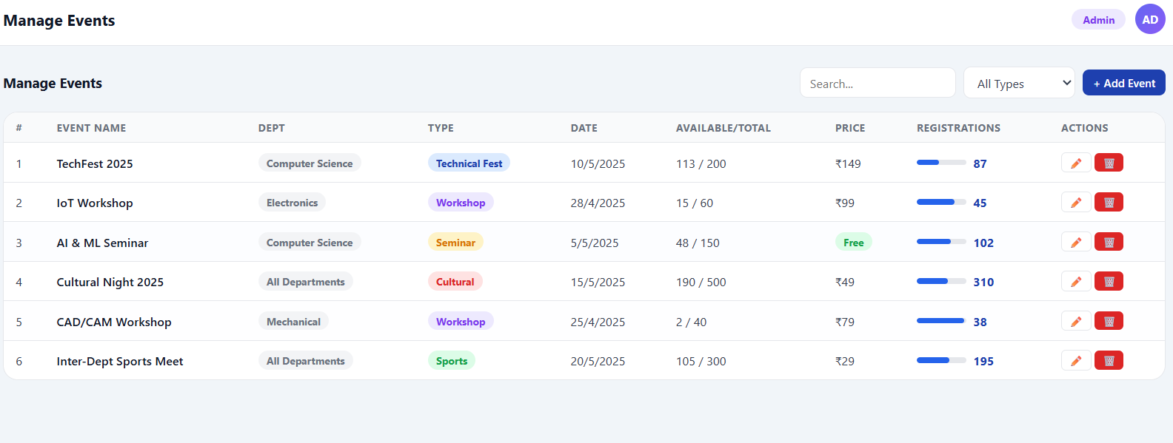
IMPLEMENTATION SCREENSHOTS
Admin page
1
2
3
4
5
6
7
8(A)
9

Slide 12
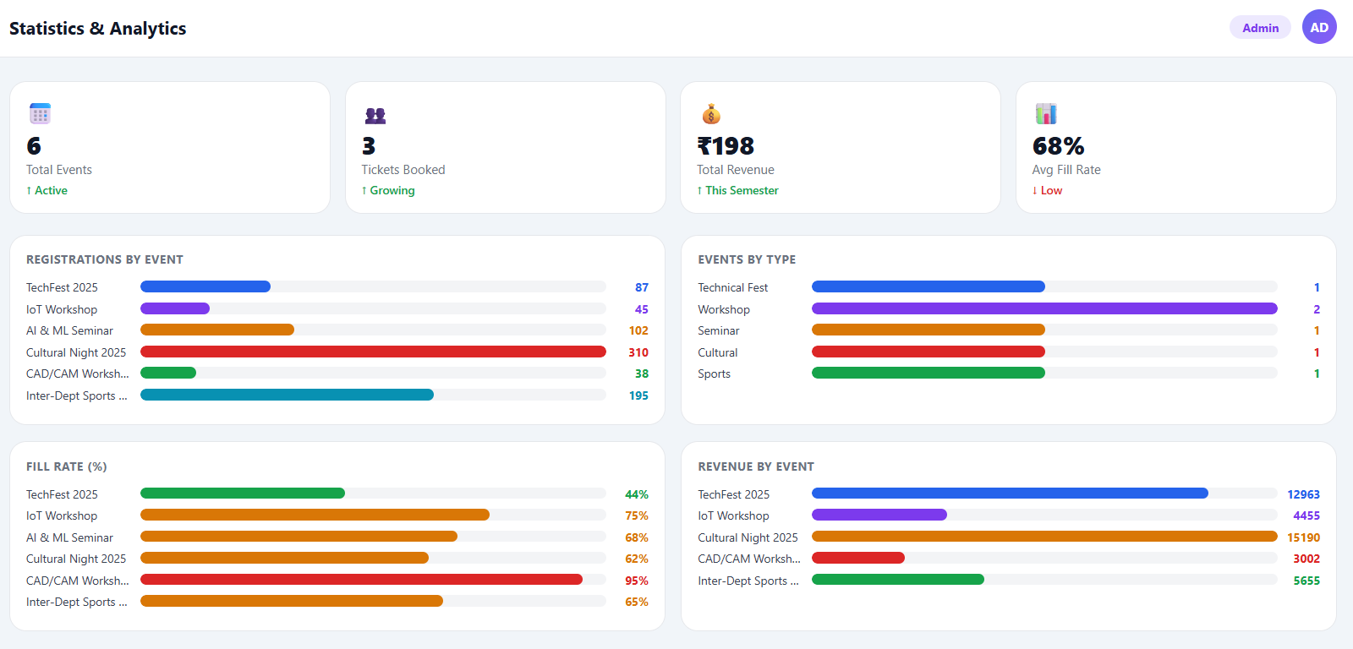
IMPLEMENTATION SCREENSHOTS
1
2
3
4
5
6
7
8(B)
9

Slide 13
ADVANTAGES & LIMITATIONS
1
Advantages:
Students can register for events online without manual work
All events (date, time, venue) available in one place
No need for manual entry or paper forms
Admin can track participants and manage events efficiently
Limitations:
Requires internet to access and register
Server or system errors may affect usage
Development and maintenance require cost
Data privacy risks if not properly secured
2
3
4
5
6
7
8
9

Slide 14
Thank you

